Slide 1
Languages for Learning: A Pedagogy for EAL
Newcastle, UK
10th-11th November 2016
Lecture 1, day 1
Dr Heather Smith
http://research.ncl.ac.uk/romtels/resources/

Slide 2
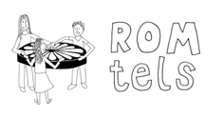
Languages for Learning:
Professor Fred Dervin, Dr Heidi Layne, Helsinki University
Newcastle University
Arthur’s Hill Federation Primary schools
Mr Nicu Gal, founder People to people foundation; Daniela Tutos, Tinca school, Romania
Associate Professor Leena Robertson, Middlesex University
Professor Nathalie Auger, Montpellier University; Christel Houée, High School State Paul Valéry (Sète, near Montpellier)
A pedagogy for EAL

Slide 3
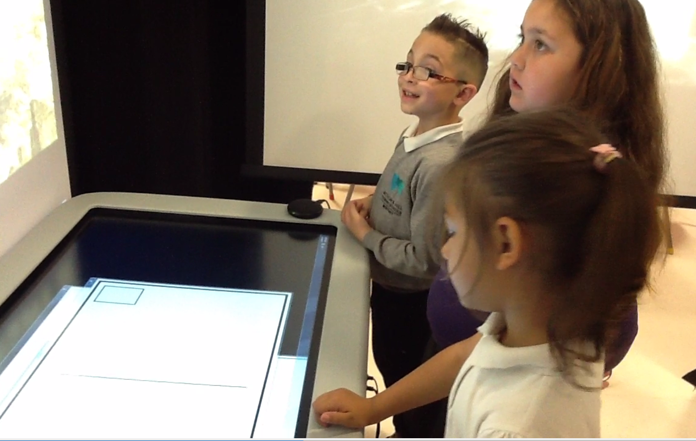
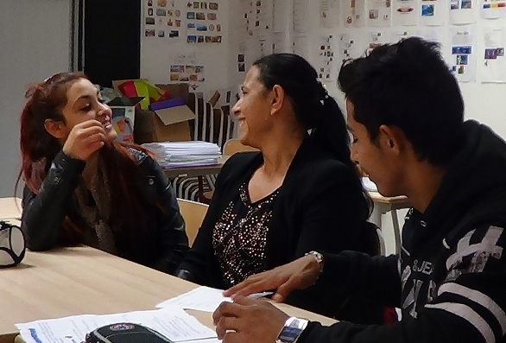
The aim of the conference is to use evidence gathered from the ROMtels research project in presenting and discussing:
ideas for supporting pupils with EAL in their everyday learning (including the learning of English) via use of their home languages as a semiotic tool for learning
ways to involve parents and communities in the everyday life of schools as language experts
exemplification of the above through work with Roma families from Eastern Europe
the number and variations of Romani dialects
the role technology can play.

Slide 4
How many languages in the world?
What/who is EAL?
Who are Gypsy Roma?
What role language status?
Why home language use for learning: research evidence?
What is the ROMtels project about?

Slide 5
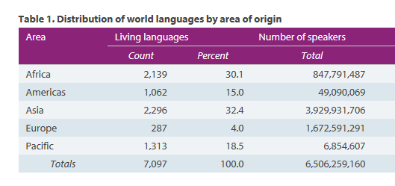
A living language is defined as one that has at least one speaker for whom it is their first language; extinct languages and languages that are used only as a second language are excluded from these counts.
https://www.ethnologue.com/statistics

Slide 6
Pupils learning English as an additional language
Simultaneous or consecutive
Literate or not
Languages with a written form or not
“pupils who live in two languages, who have access to, or need to use two or more languages at home and at school. It does not mean that they have fluency in both languages or that they are competent and literate in both languages” (Tower Hamlets, 1992)

Slide 7
More than 360 languages spoken in UK
http://www.naldic.org.uk/research-and-information/eal-statistics/eal-pupils/

Slide 8
‘Rather than working with homogeneity, stability and boundedness as the starting assumptions, mobility, mixing, political dynamics and historical embedding are now central concerns in the study of languages, language groups and communication’
(Blommaert and Rampton, 2011, p. 3)
In the course of the 19th century, most, if not all, European nation states used national languages to trigger unity, assess loyalty and govern public participation (Gogolin 2010, pp. 536-537). In this context, national institutions, and especially schools, developed the imagery of monolingualism as being a natural norm, while perceiving bilingualism and multiculturalism as disturbing or even threatening (ibid.). This “monolingual habitus” (Gogolin 1994) is still prevalent in European schools (Brüggemann, C. (2012).

Slide 9
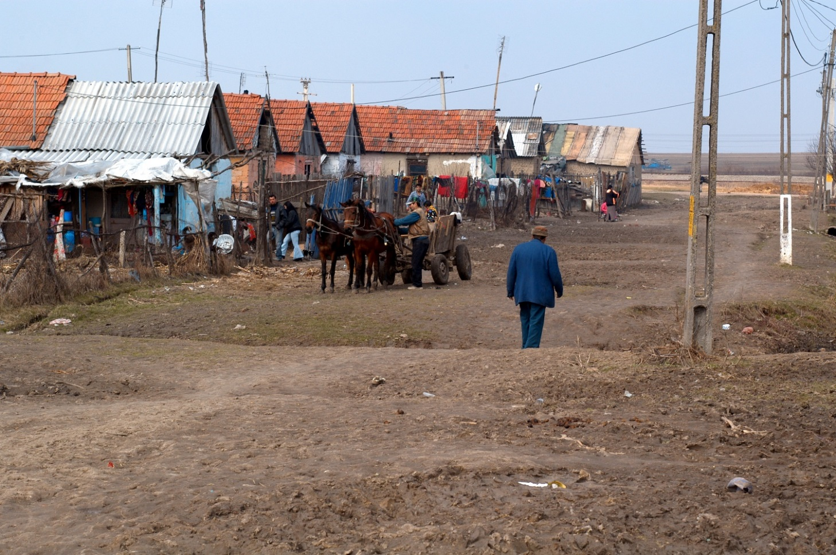
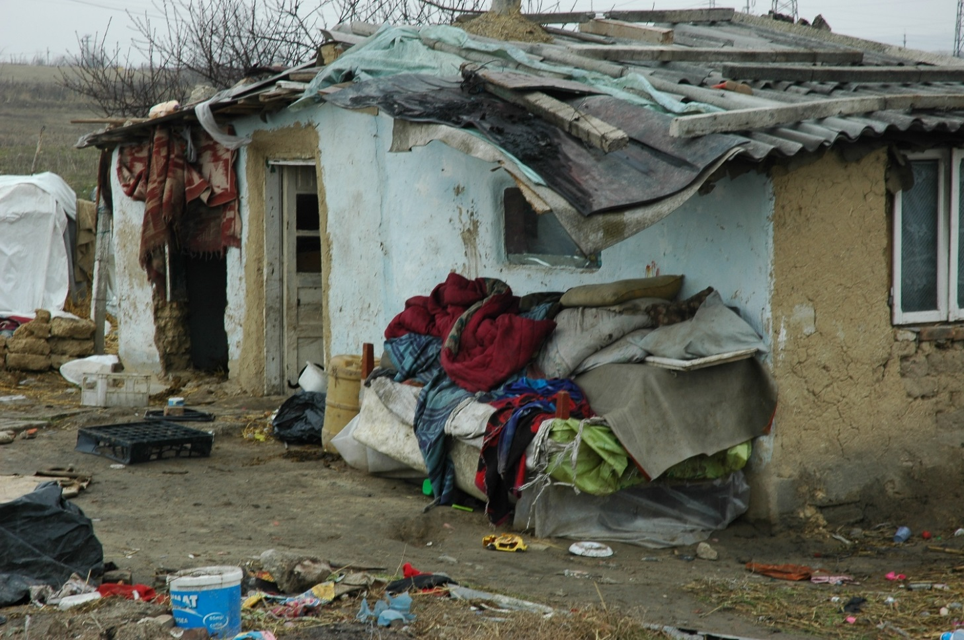
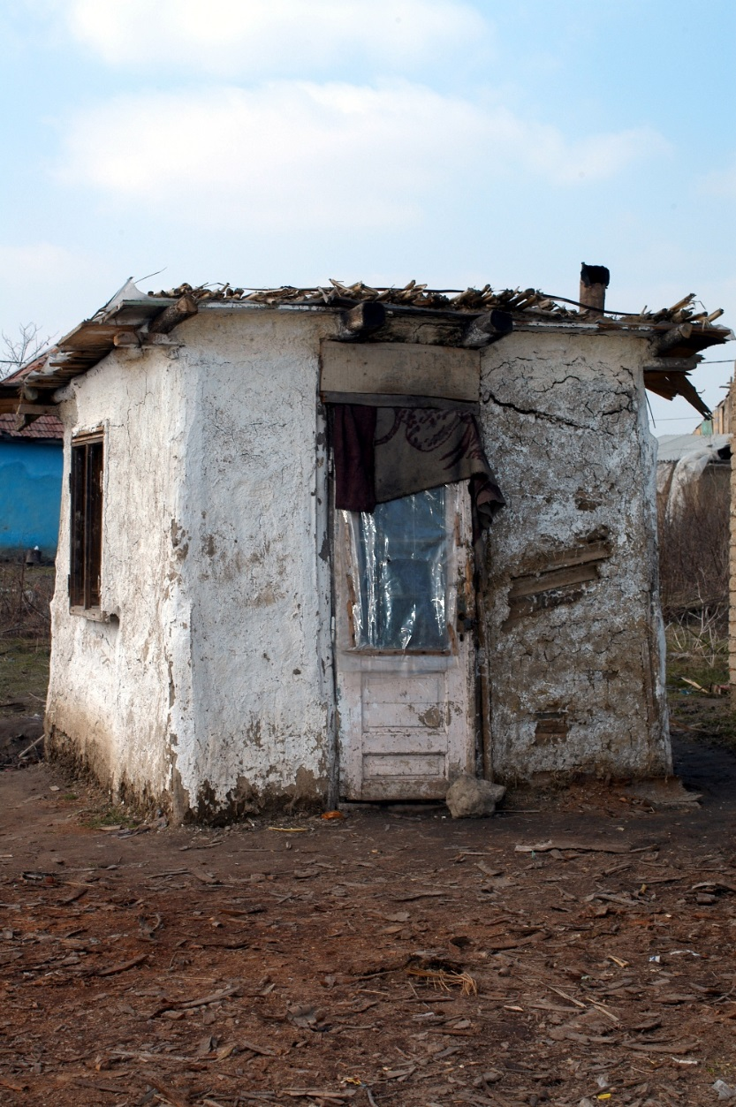
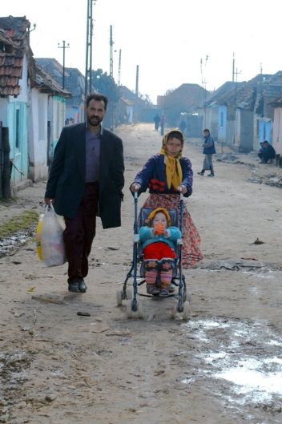
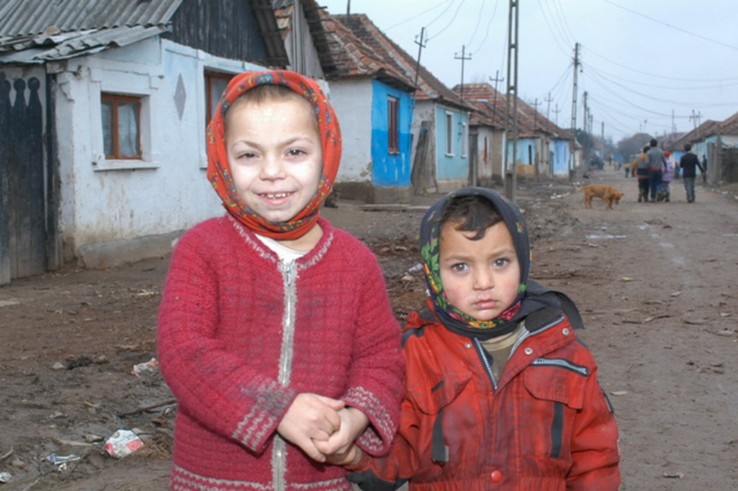
Gypsy Roma
Most deprived and discriminated ethnic group in Europe, often negatively stereotyped, so parents often reticent to acknowledge this heritage let alone their languages.
Most likely to be inappropriately placed in special needs classes in some European countries
Parents often have either personal knowledge or family histories of prejudiced behaviour in institutions such as schools
lowest achieving pupils across Europe including UK
Hugely complicated language systems deriving from India – multiple linguistic forms
No commonly agreed standardised written form

Slide 10
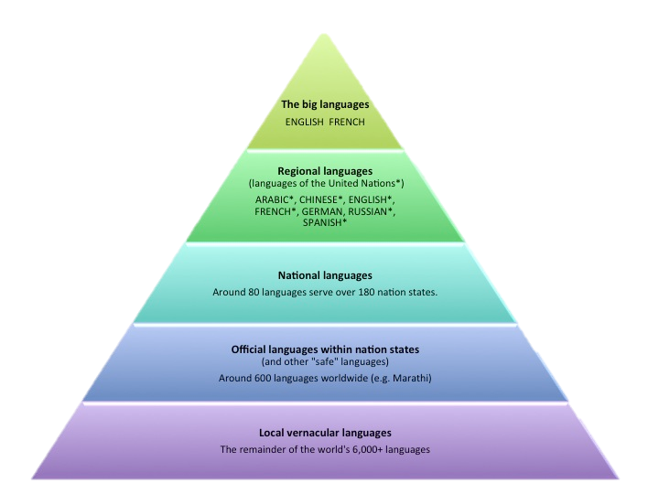
Language status
Language status matters because ….
Early theories of bilingualism proposed that when a child’s second language is valorized at the expense of their home language, it leads to a cognitive disadvantage or subtractive bilingualism (Hamers and Blanc, 1989)
Adapted from Graddol, 1997
“being a member of a low-status language group may have negative effects on self-concept, motivation and/or learning opportunities, all of which can depress literacy attainment (p.258)” Report of the National Literacy Panel on Language-Minority Children and Youth in USA (August & Shanahan, 2006):

Slide 11
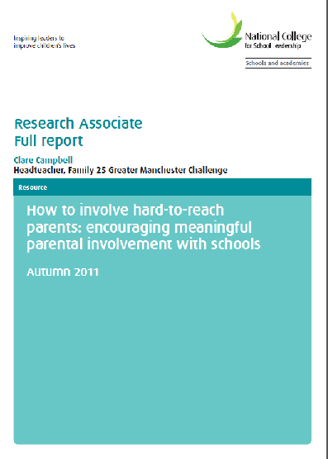
And some communities are situated within public policy and professional discourse as ‘hard to reach’
“Drawing together the issues identified above, this research study thus defines hard-to-reach parents as those who:
— have very low levels of engagement with school
— do not attend school meetings nor respond to communications
— exhibit high levels of inertia in overcoming perceived barriers to participation” (p.10)

Slide 12
So, what is required?
A shift in attitudes from expectations of:
a classroom as a monolingual context to a recognition of the messy reality of linguistic pluralism
'Plurilingualism' refers to the repertoire of varieties of language which many individuals use, and is therefore the opposite of monolingualism; it includes the language variety referred to as 'mother tongue' or 'first language' and any number of other languages or varieties.
and of some parents/communities as ‘hard to reach’ to an acknowledgement of their linguistic expertise as ‘funds of knowledge’ (Moll 1992).

Slide 13
The way forward? ….. A Translanguaging Pedagogy
Encouraging and enabling the use of pupils’ home languages as a natural semiotic tool for learning alongside the language of school.
But why and how?
After all, teachers cannot possibly learn the languages of all the children who enter their classrooms
AND surely it is counter-intuitive to submersion/sink or swim approach
BUT research evidence over 15 years strongly suggests otherwise

Slide 14
A study of 11-year-olds in Hackney who routinely used three languages in addition to English showed these children outperforming monolinguals from similar backgrounds, and, atypically, boys ahead of girls in their reading (Sneddon, R., 2000/2008)
Research by Jim Cummins of the Ontario Institute for Studies in Education, shows that bilingual children perform better in school when the school effectively teaches the mother tongue and, where appropriate, develops literacy in that language. By contrast, when children are encouraged to reject their mother tongue and its development stagnates, their personal and conceptual foundation for learning is undermined. (Cummins, J., 2003)
Thomas and Collier’s large-scale study of different approaches to the education of children learning English as an additional language in the US proved conclusively the superiority of education using their own language as well as English over an English only approach in terms of overall academic achievement. (Thomas, W. and Collier, V., 2001)
A study of London secondary school students from Portuguese backgrounds found that those who had attended Portuguese classes were five times more likely to obtain five or more GCSEs at A*–C than those who had not been encouraged to develop their home language (Barradas, O., 2000/2003 )

Slide 15
Critical factors
The factors which prevent children without the language of instruction from reaching their potential are:
Schools without sufficient resources and staff with competencies to support the learning of migrant children;
Assessment tools and assessors with negative perceptions of migrant children’s abilities which allocate more of them to lower ability tracks and special education classes;
A lack of opportunities to develop their mother tongue competences to higher levels.
Attitudes and perceptions are crucial
There is indicative evidence that the following are beneficial:
Increasing all children’s cultural and linguistic awareness through both language learning and other parts of the curriculum;
Engaging parents in the school’s activities and their children’s education;
Increasing teachers’ positive attitudes towards migrant children’s prospects
and their use of their mother tongues to learn
European Commission, 2015 study of existing research and meetings with experts.

Slide 16
ROMtels: Roma (or any other language group) translanguaging enquiry learning space)
ROMtels: home language use ought to be a normal aspect of everyday classrooms in support of learning and pupil dignity. So, what happens when home language use is not just accepted but enabled?
This is an approach which assumes a reality known as translanguaging and which adopts this reality in linguistic presentation of teaching resources.
We started with the notion that high status technology might raise the status of Eastern European Roma pupils’ and families’ languages, whilst acknowledging the families and pupils’ linguistic expertise, thereby supporting them in enabling us to draw on their ‘funds of knowledge’ (Moll, 1992).
If we were right, then this could be applied to other less high status languages and language communities.
So, back to today and tomorrow, we will share what we have discovered and discuss what you think. We will ask you to critically reflect on current school practices and to arrive at new ideas. This is how…..

Slide 17
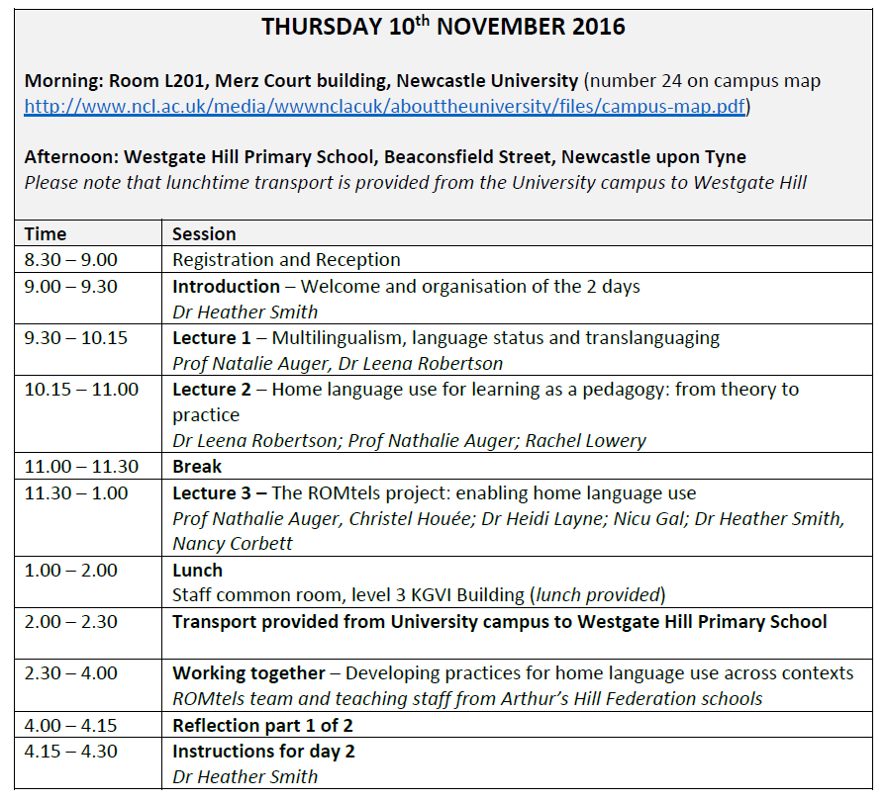
Please ensure you bring examples of the following for use on Friday: forms (or other means of collecting data) about children’s languages; policies relating to how parents (whose first language isn’t English) are supported in participating in school events such as teacher parent meetings, open assemblies, support opportunities, visits out of school?; examples of practice of parental involvement.
Who would prefer to drive there themselves?

Slide 18
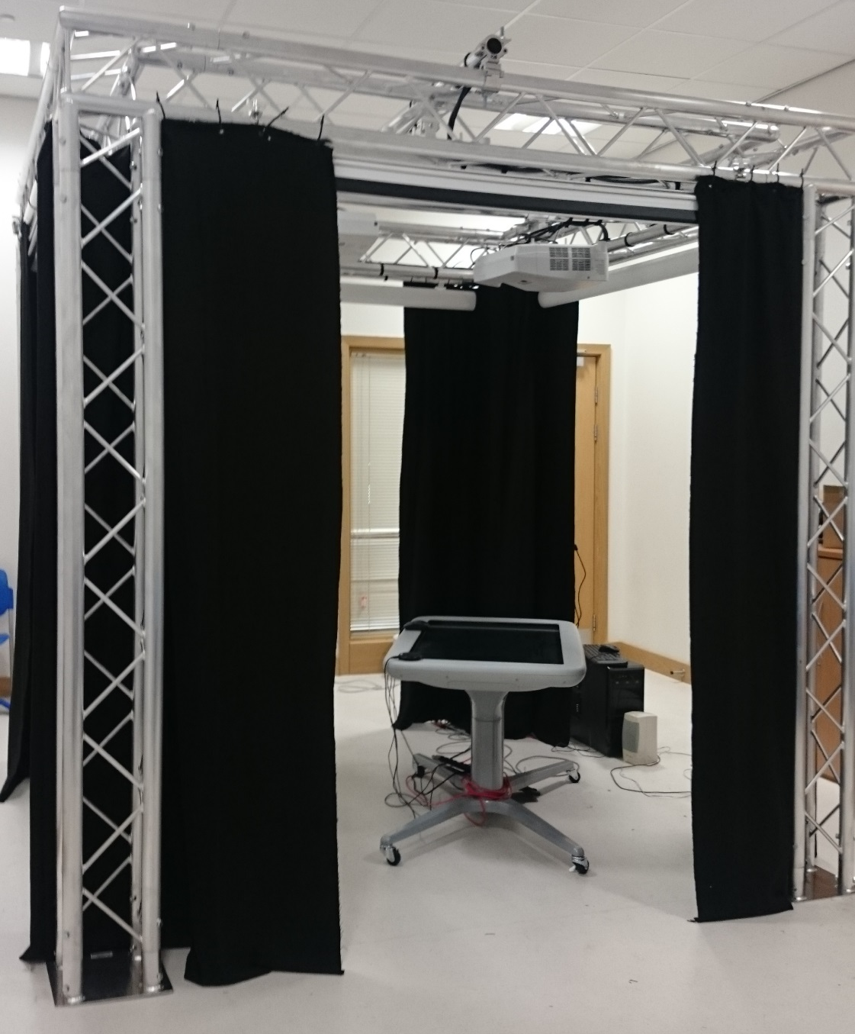
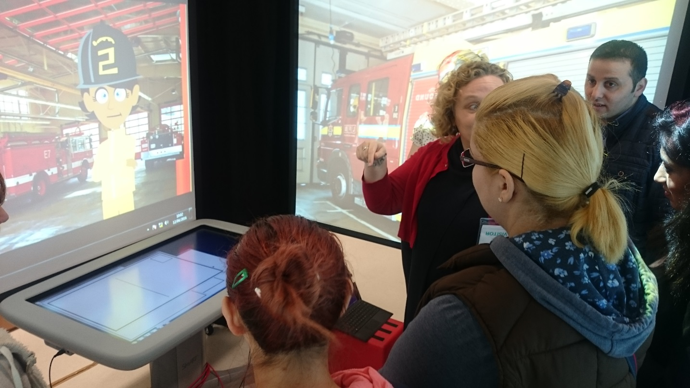

Slide 19
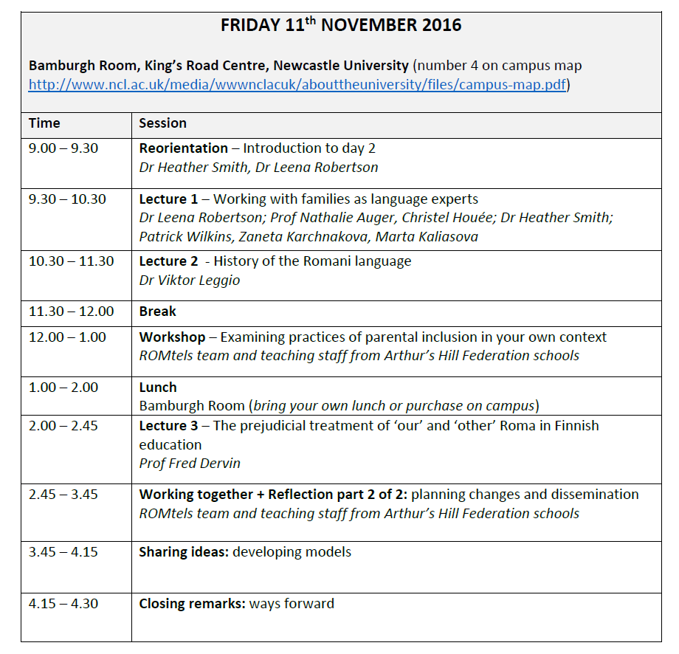

Slide 20
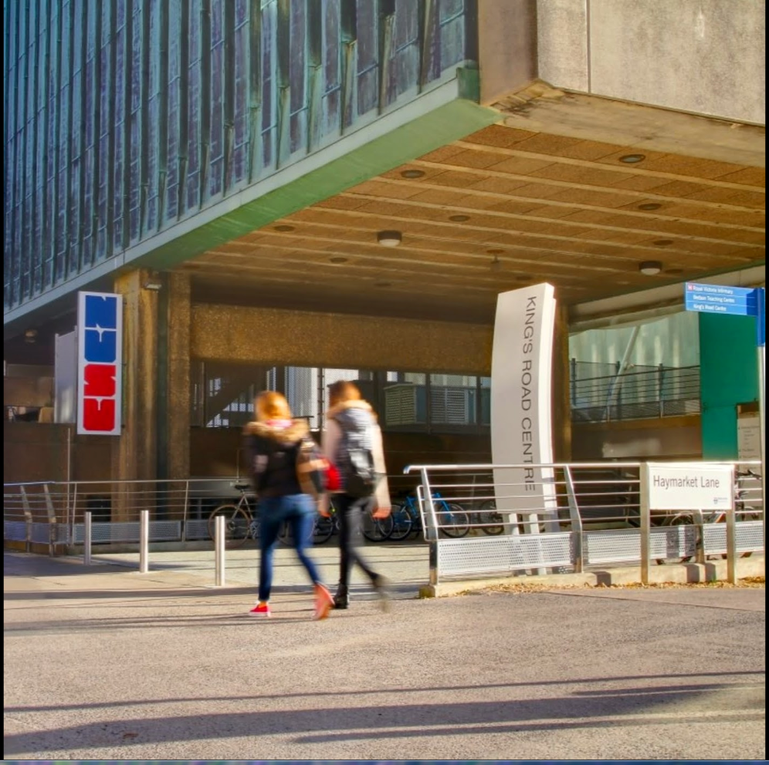
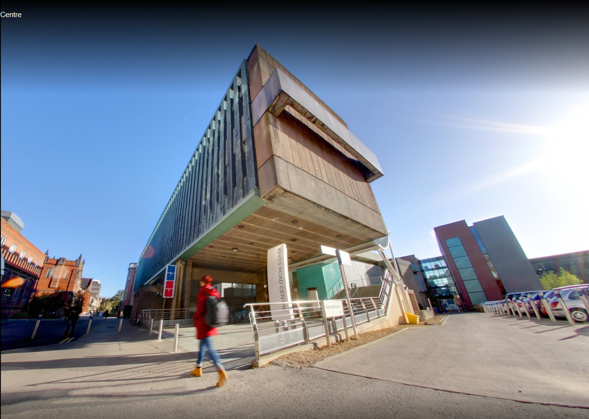

Slide 21
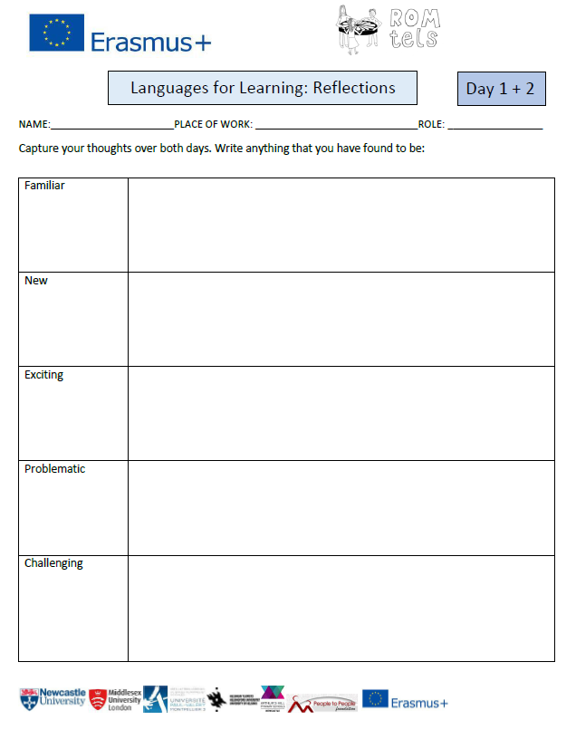
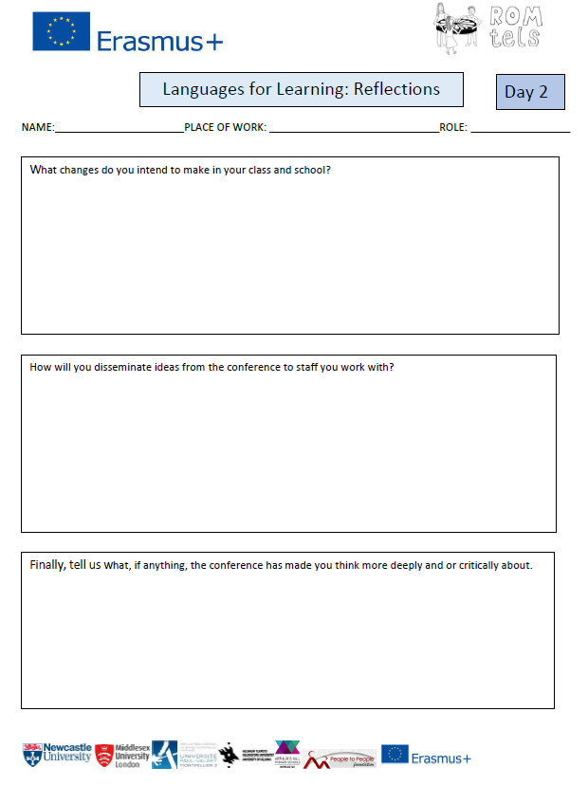

Slide 22
Friday 11th October: refreshing memories, reorientation and introduction to day 3
Memories from the floor
Reorientation: the focus of today is working in partnership with families
ALERT! If you have to leave at any stage before 3.45pm, please don’t forget to complete your reflections sheet for our research

